Slide 1
Music Churn Prediction
Members
Akhilesh Chandrashekar ab10138
Himanshu Kumar hk3427
Aakash Shetty aks9108

Slide 2
Introduction
Many businesses now use a subscription-based business model for their businesses.
Attrition analysis provides such companies with a better understanding of their customer retention and ways of keeping their customers.
Attrition analysis reduces customer churn rates and helps a business understand the steps necessary for preventing voluminous loss of revenue due to customer churn.
Churn may also apply to the number of subscribers who cancel or don't renew a subscription.
The higher your churn rate, the more customers stop buying from your business.

Slide 3
Why is Churn Rate Prediction Important?
According to a survey conducted by eMarketer, 34% of Americans say they’ll probably sign up to more subscription services over the next two years. The average American has three currently.
Big Players such as Netflix, Amazon, Google and Apple are concentrated on Refining the Subscription Experience for their various services.
Refining the subscription experience does rely heavily on the effective collection, monitoring and use of customer data, which large companies like Netflix, Microsoft and Amazon have in heaps.
Having the ability to accurately predict future churn rates is necessary because it helps your business gain a better understanding of future expected revenue.

Slide 4
Why Big Data?
While the app deals with millions of users on a daily basis and provides subscriptions to most of the users it will be really helpful to use big data to help grow and monitor their business.
Netflix alone generates 500 million GB’s of data daily from their user .
Companies like prime, netflix, spotify collects data, such as, a user's watch history, search queries, and time spent using their service and many more.
Using advanced big data and analytics tools becomes crucial to deal with remarkably large datasets.
Consumer churn rate is one of the important concerns in subscription based companies like netflix, spotify, new york times etc.
Churn rate prediction requires us to navigate through huge data sets and apply analytics to get desired data inferences for prediction.

Slide 5
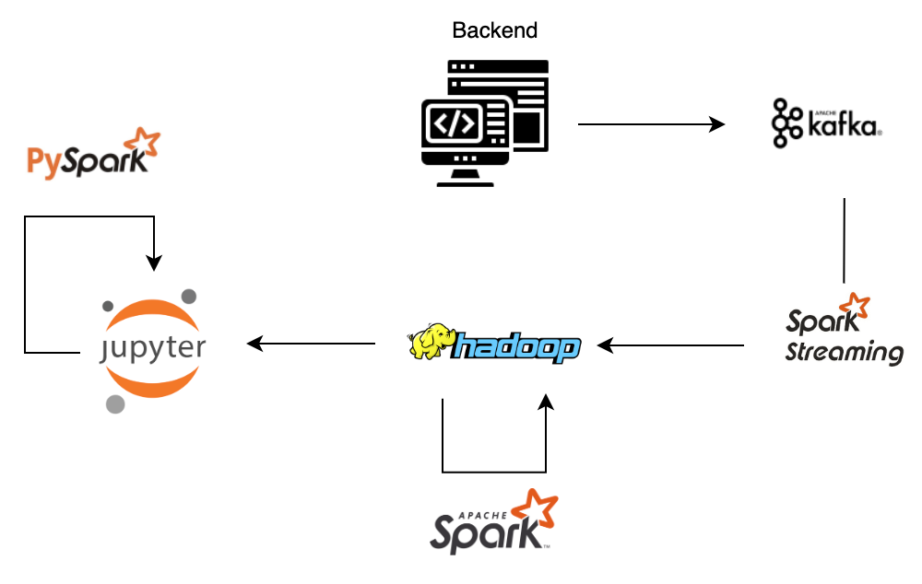
Big Data Pipeline

Slide 6
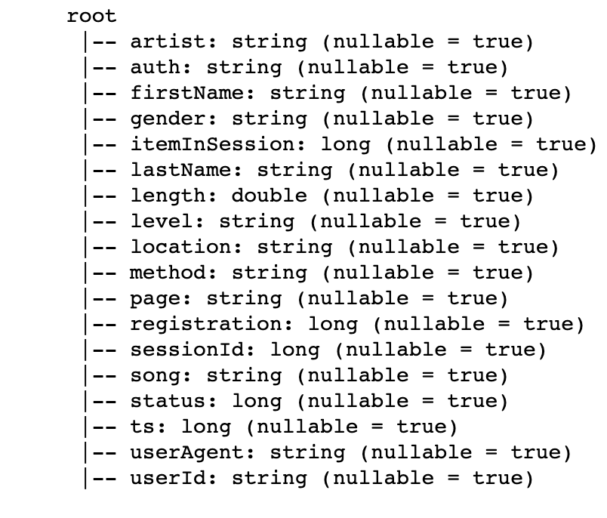
Our Dataset
We have a 12 GB dataset with following columns and schema. It is a JSON formatted data and has in total 26259199 number of records.

Slide 7
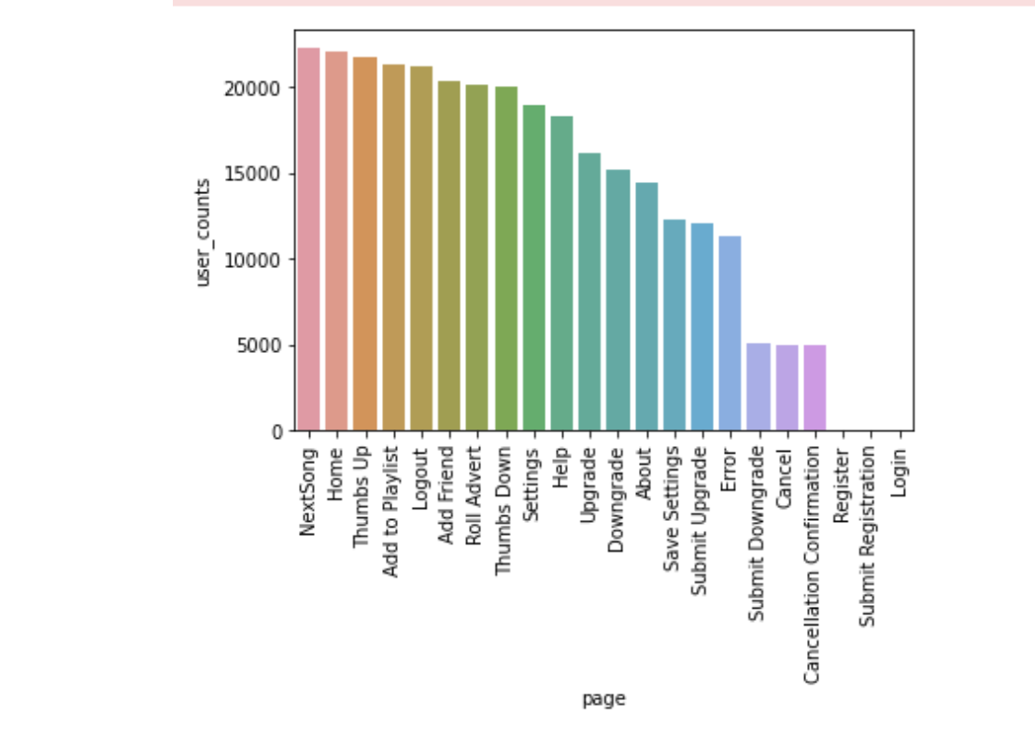
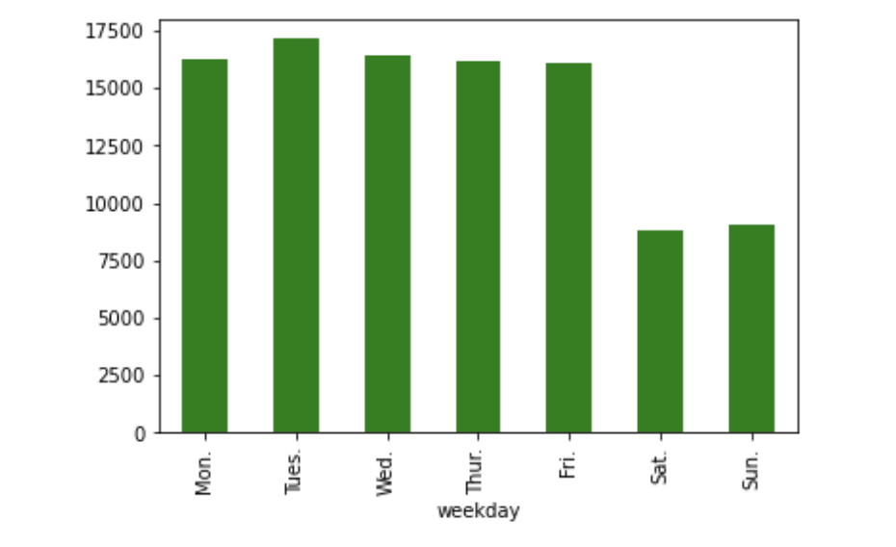
Data Exploration

Slide 8
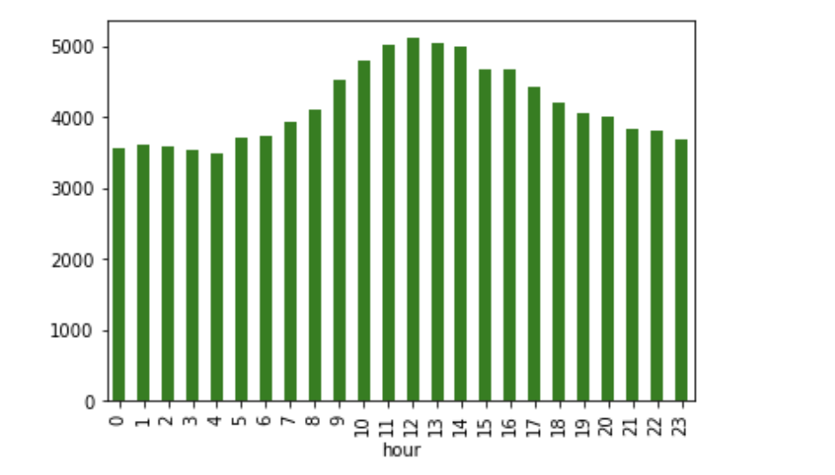
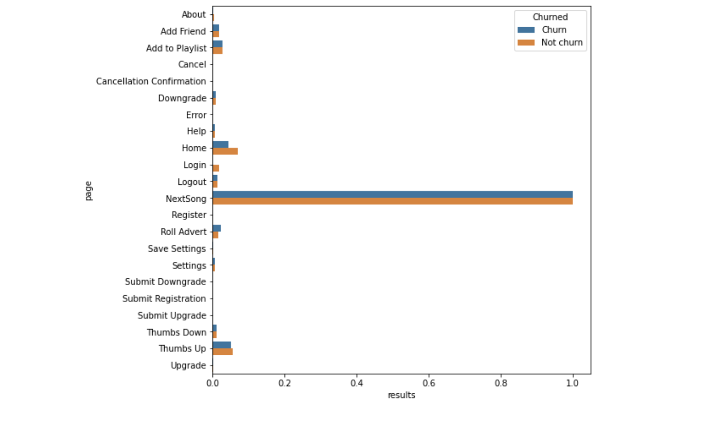
Data Exploration

Slide 9
Feature Extraction and Engineering
While dealing with large amounts of data it is important to know which features will be important for our churn rate as we cannot have unnecessary data taking up memory/time and affecting our results.
An intuitive example can be columns such as first name and last name are not relevant and should be discarded while features like time spent on the app can be crucial for our churn prediction
Now, features extraction is also a important step. As said earlier time spent on app can be crucial but time spent is not directly implied by our dataset. So, we have to extract such features from timestamp column.
In this way we have tries to extract relevant data from existing columns to get number of likes and dislikes, number of errors, sharing activity etc.

Slide 10
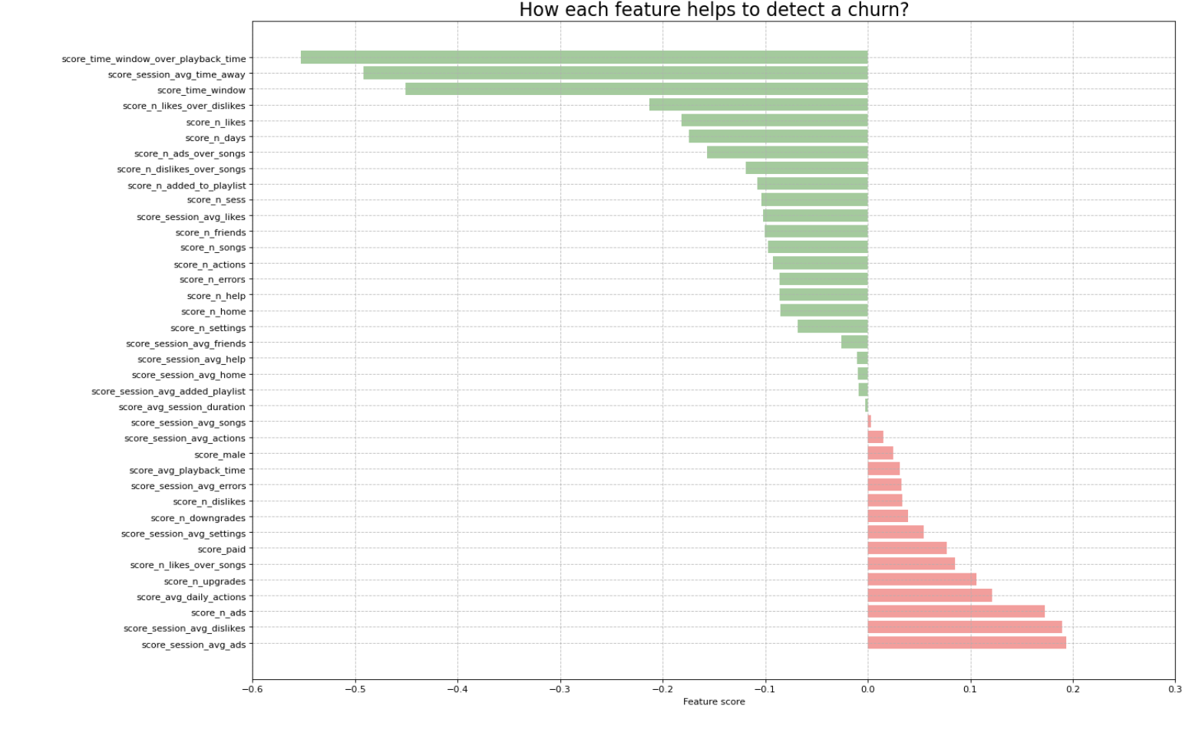
Feature Extraction and Engineering

Slide 11
Model Training and Testing
For Model we select four models to train and test our data and select the best model out of the four.
Linear Regression, Decision Tree, Random Forest, Gradient Boost.
For our model we have few important metrics like recall, F-score and AUC.
Recall cares about our positive predictions as that will decide the organizations next steps towards the prediction.
To balance the negative predictions we also care about the F-score because we cannot end up sending discount coupons to everyone and end up affecting our revenue.
We also use AUC, area under the curve which allows us to plot true positive against false positives.

Slide 12
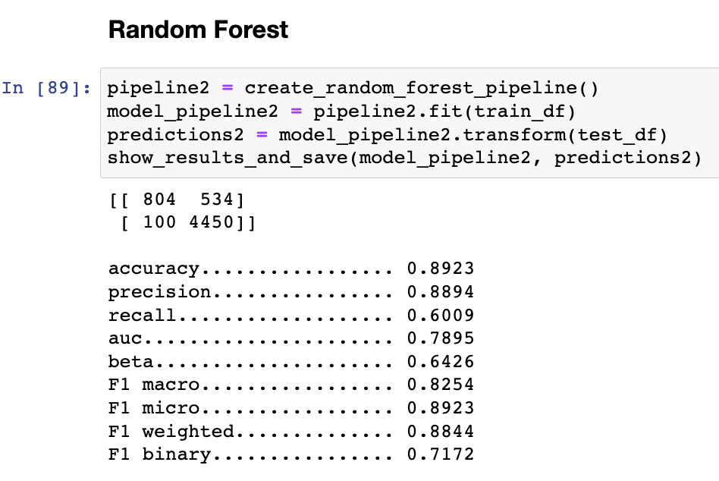
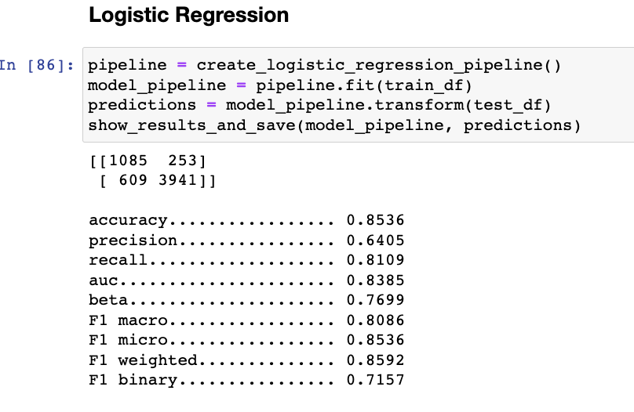
Results

Slide 13
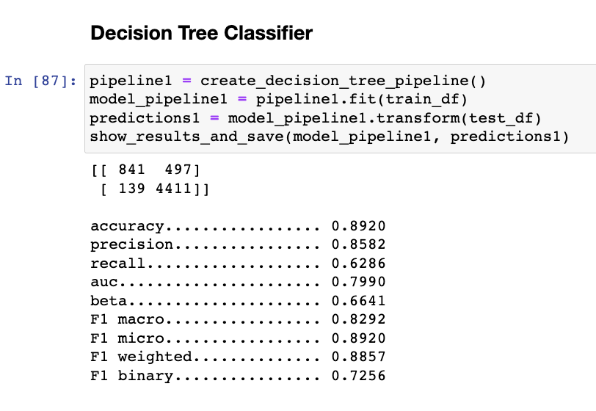
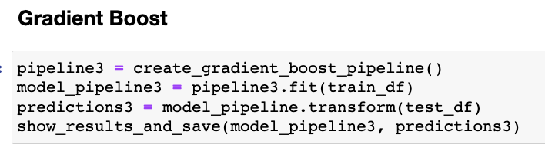
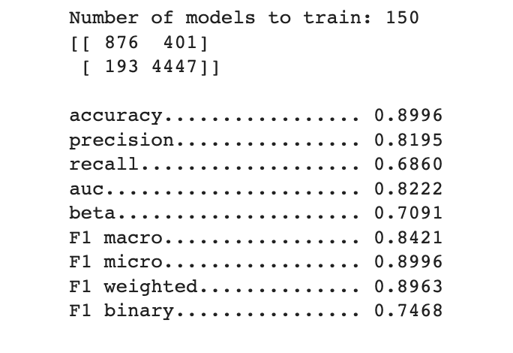
Results

Slide 14
Acknowledgement
We thank Professor Juan Rodriguez/TAs for teaching the material on big data analysis, for answering our questions and for helping us develop an immense interest in big data. They equipped us with the necessary skills and knowledge to finish a project of this magnitude and complexity. We also are extremely thankful to the teaching assistants for their contribution towards strengthening our conceptual and technical understanding of the various topics in big data.

Slide 15
Future Work
Scalable analytics and visualizations using Dask
Deploying a full scale application on amazon cloud using Amazon EMR.
Involving deep neural networks to improvise the model performance.

